Slide 1
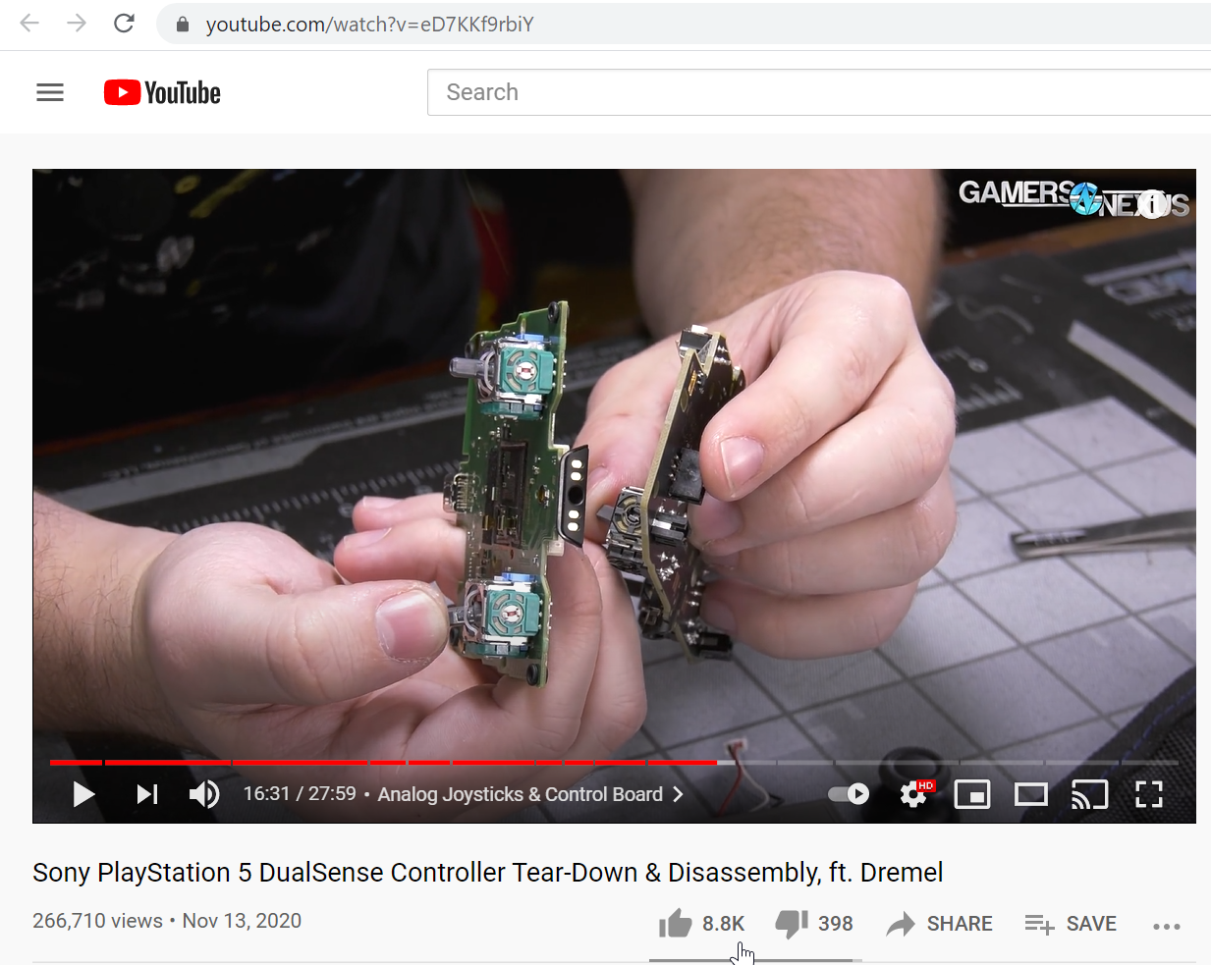
Notes:
PS5 joystick tear down. Also shows Google Stadia.
https://youtu.be/eD7KKf9rbiY

Slide 2
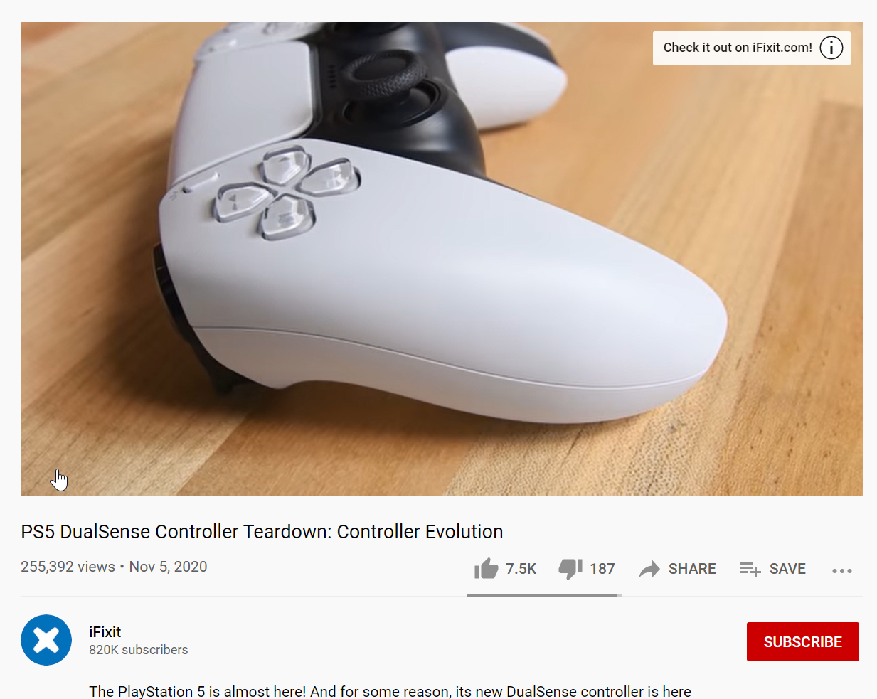
Notes:
https://youtu.be/viqj_MWjb4I

Slide 3
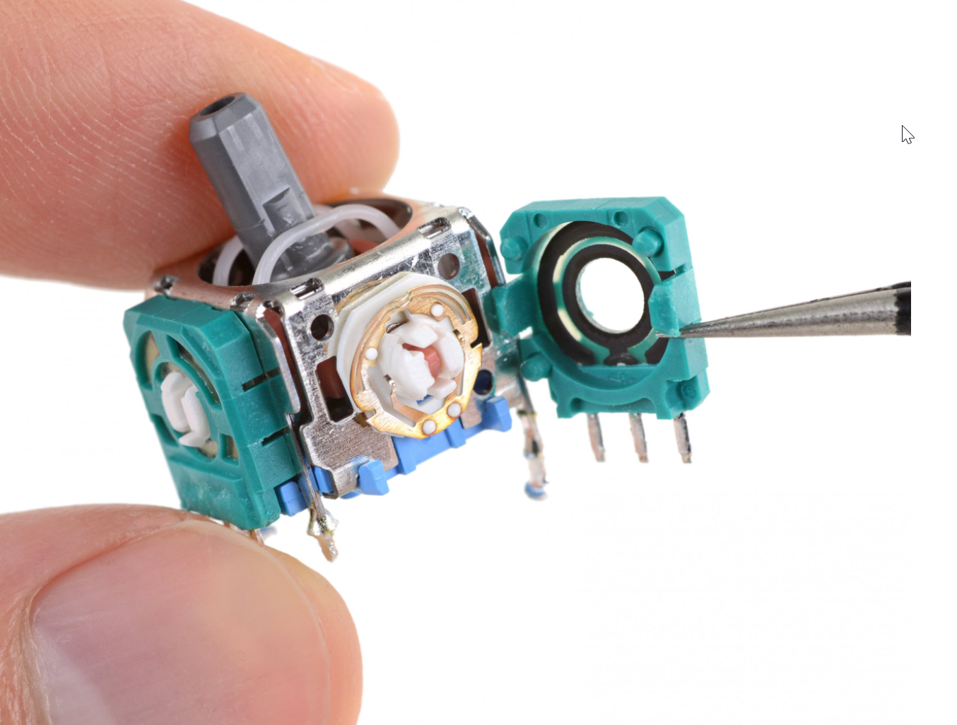
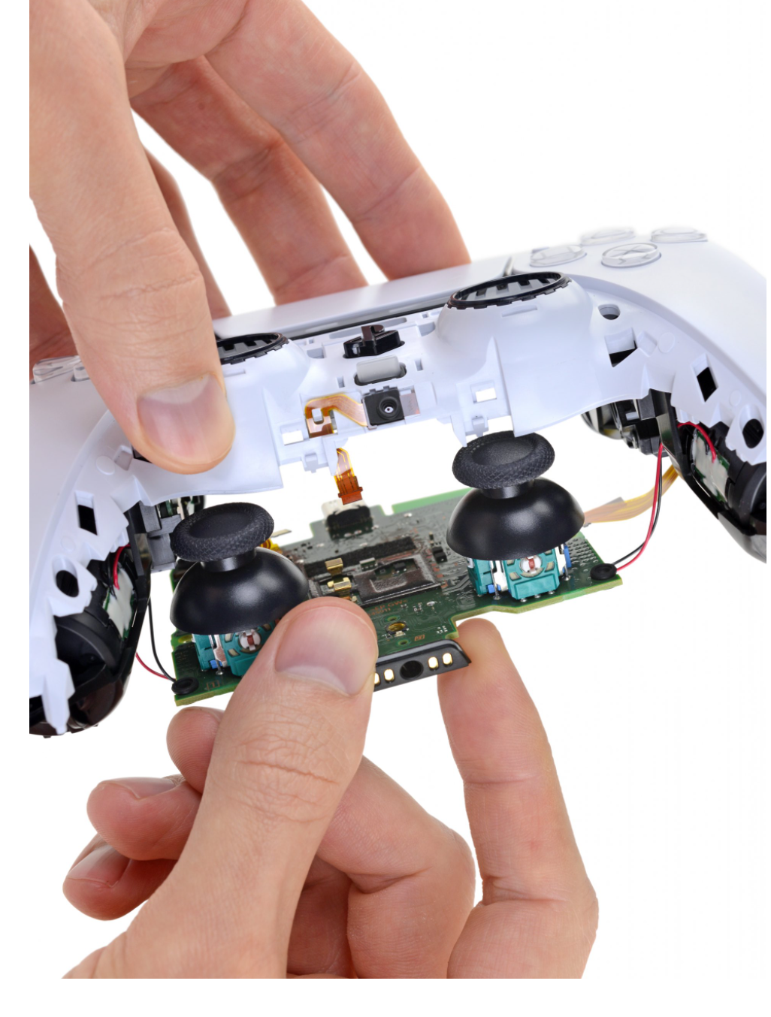
Tempting as it may be to blame Alps for the PS5’s drifting issues, they probably aren’t the villain of this story—because, brand name notwithstanding, this joystick module looks extremely familiar. You may already recognize it from the prior-gen PlayStation’s controller, the DualShock 4. Or from the Xbox One controllers. Maybe the Nintendo Switch Pro controller. Or, somewhat confusingly, the $180 Xbox One Elite controller. Underneath that plastic cap, the dirty secret is that they all use the same joystick hardware.
Notes:
https://www.ifixit.com/News/48944/heres-why-ps5-joysticks-drift-and-why-theyll-only-get-worse

Slide 4
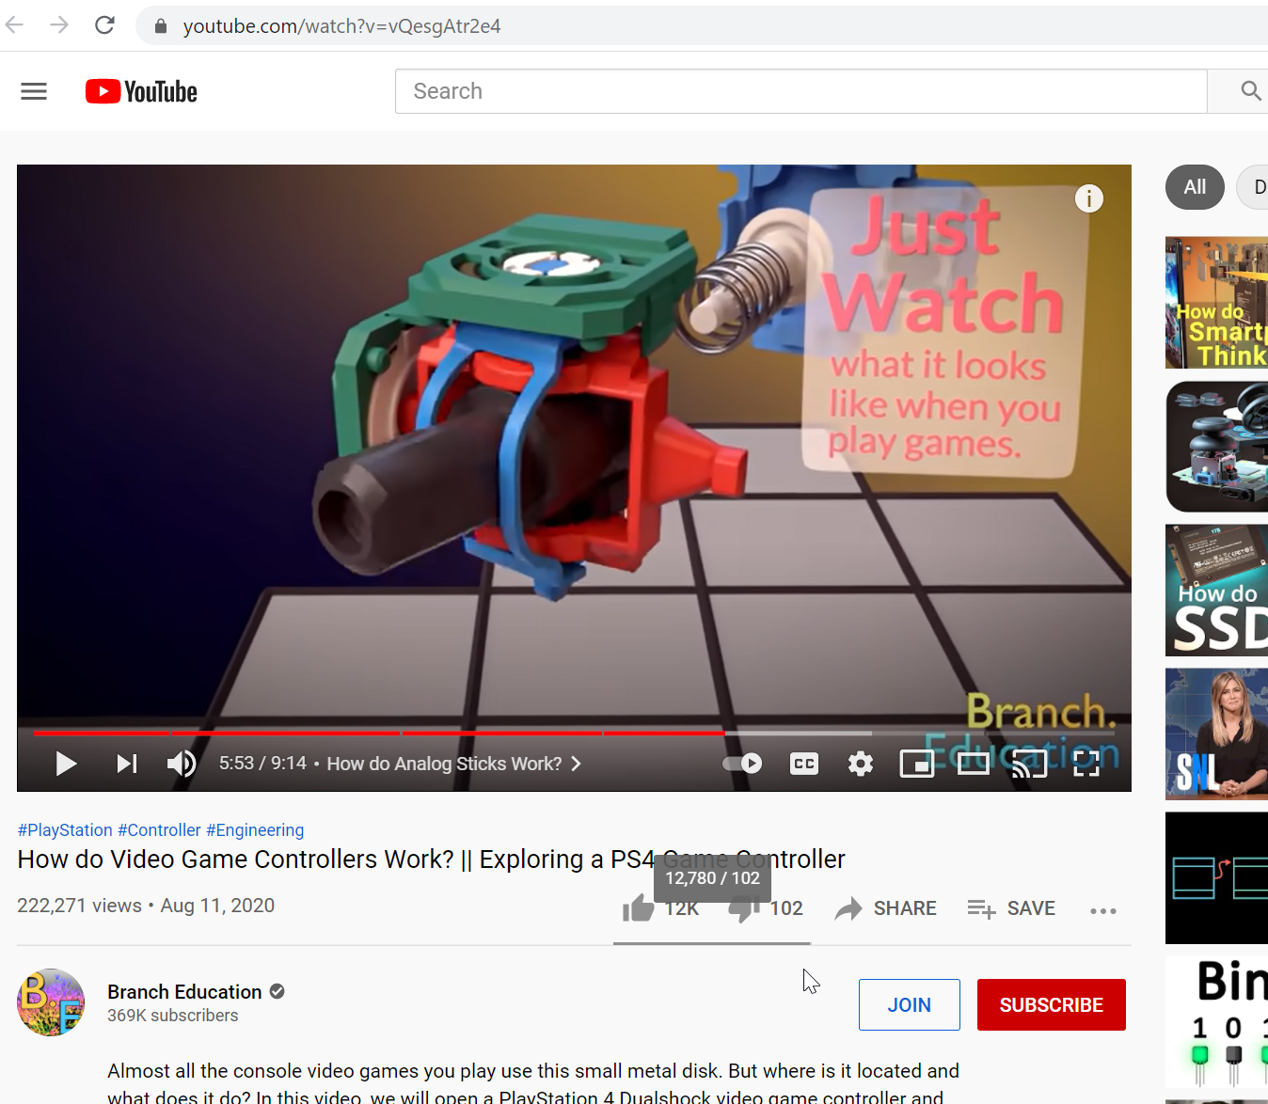
Shows animation of how potentiometer works in joystick
Notes:
https://youtu.be/vQesgAtr2e4

